Slide 1
Integrated Communities Pilot
Update
March 2023

Slide 2
Walsall For All - outcomes
Outcomes:
432 Participants
36.3% with a health condition
36.3% Lone Parents
31.2% participants supported into work
49.7% participants went into a training opportunity
52% participants from the White community
48% participants from the Black and Minority ethnic communities

Slide 3
Community Connector role
DWP recruited 3 Community Connectors to achieve the aims of the Green Paper through employability, by working with:
women from the north of the Borough where the community is mainly white
women from south of the Borough where the community is mainly from the BAME communities
women returning to the Labour Market.
The outreach team focused on delivering the Walsall's Integrated Communities Pilot in four of the most deprived Wards, primarily:
Bloxwich/ Blakenall Wards (north)
St Matthew’s/ Pleck Wards (south)
The purpose of the Community Connector role was to inspire women engaged with the programme by promoting the positive impact of employment, advocating the benefits both to their personal independence and financial position.

Slide 4
Place Based Approach
The Community Connector’s outreach programme identified women for whom a more holistic, intensive and one-to-one person-centred support service would be more effective.
They responded to the needs of the local community by delivering sessions at several different outreach locations:
Women's Refuge - fortnightly sessions
The Probation Service - monthly sessions
A’aina Community Hub - weekly Sessions
Palfrey Infant School - 6 week programme.

Slide 6
Empowering Women’s Workshop Tranche 1
July 2019 Workshop

Slide 7
Empowering Women's Workshop
 | Attended | Aven | Work | Walsall College | Other Courses | Counselling | Volunteering | Work Exp
Tranche 1 | 92 | 12 | 24 | 17 | 11 | 2 | 4 | 2
Tranche 2 | 113 | 20 | 27 | 28 | 27 | 7 | 5 | 9
TOTAL | 205 | 30 | 51 | 45 | 38 | 9 | 9 | 11

Slide 8
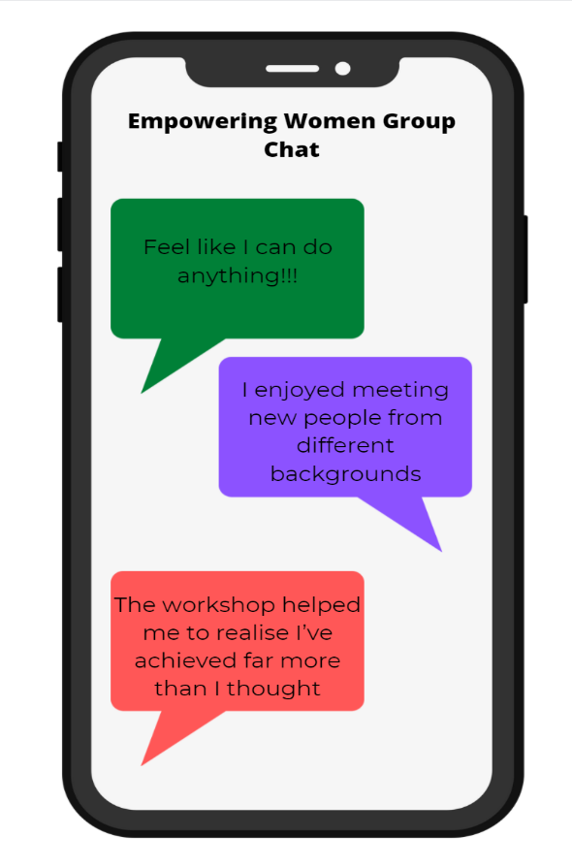
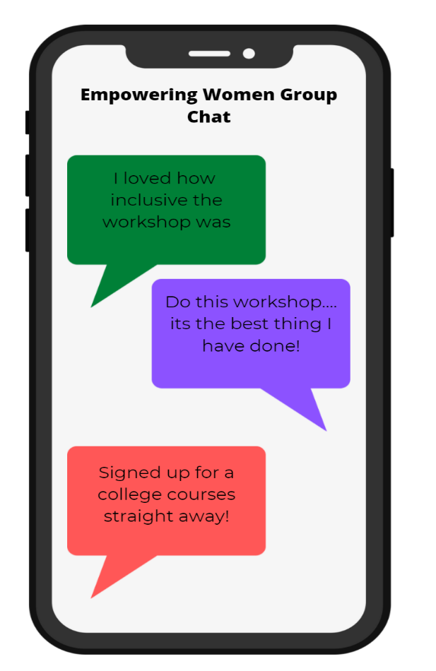
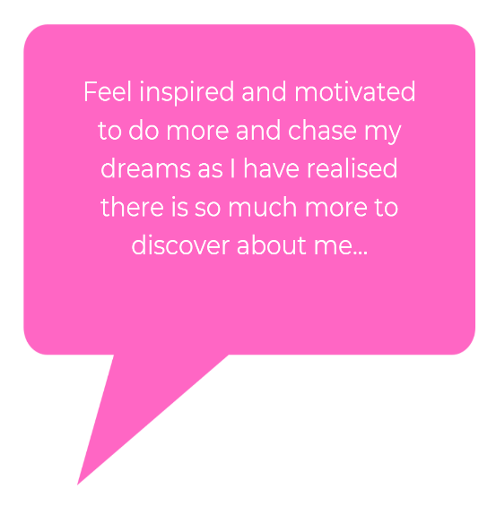
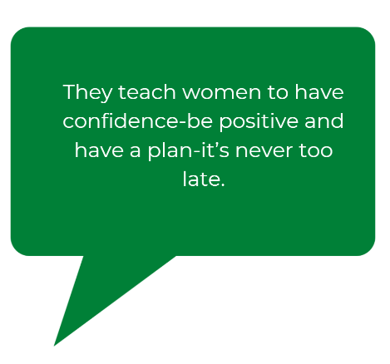
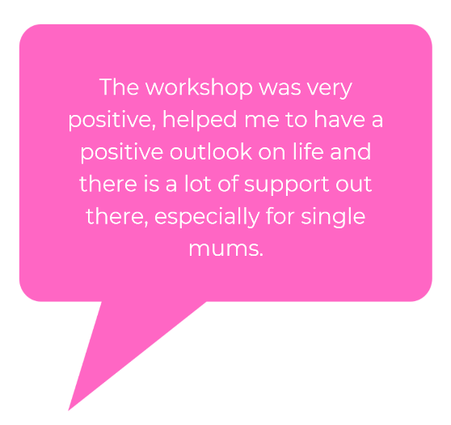
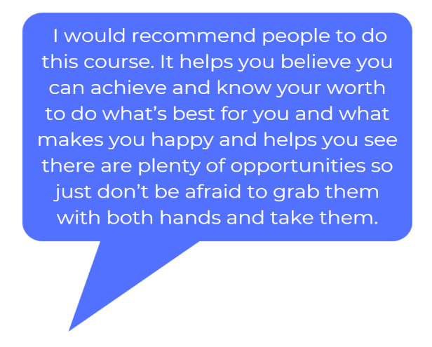
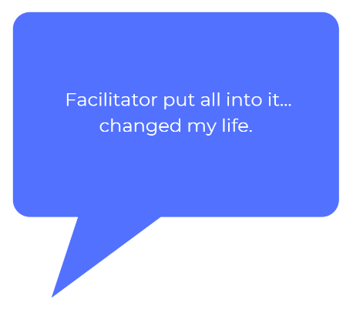
Empowering Women’s Workshop Feedback

Slide 10
Motivate Your Mind Workshop Delivery
 | Attended | Work | Walsall College | Other Courses | Bridges Project | Volunteering | Work Exp
Workshops | 57 | 12 | 6 | 10 | 26 | 4 | 1

Slide 11
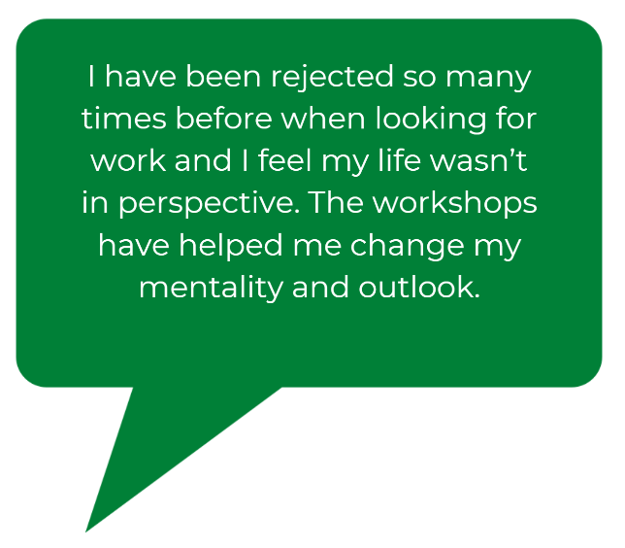
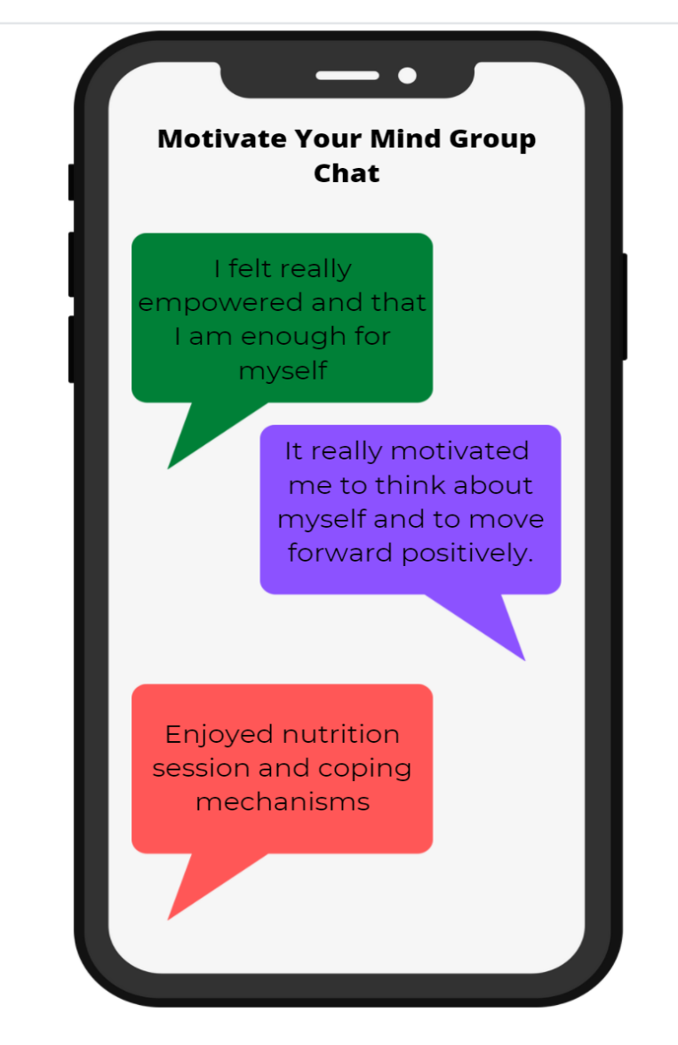
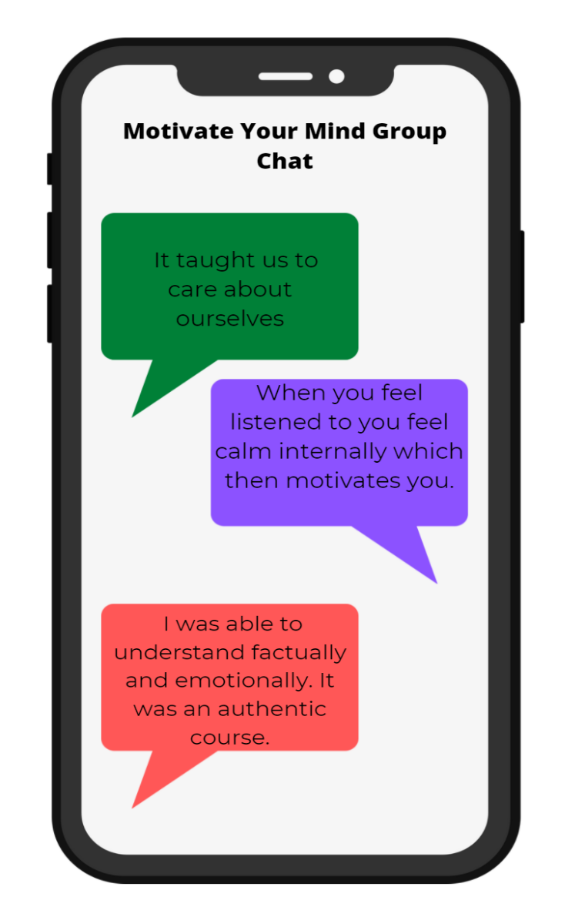
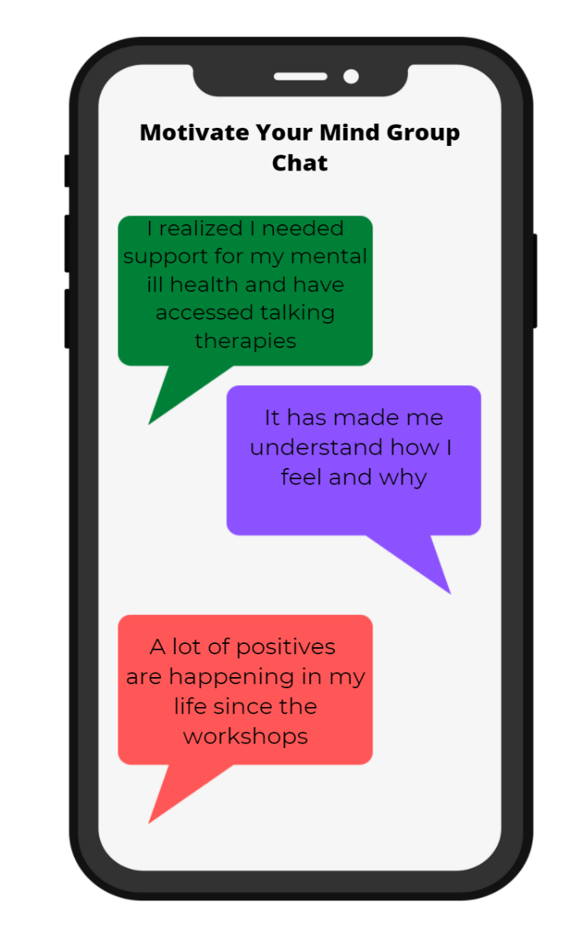
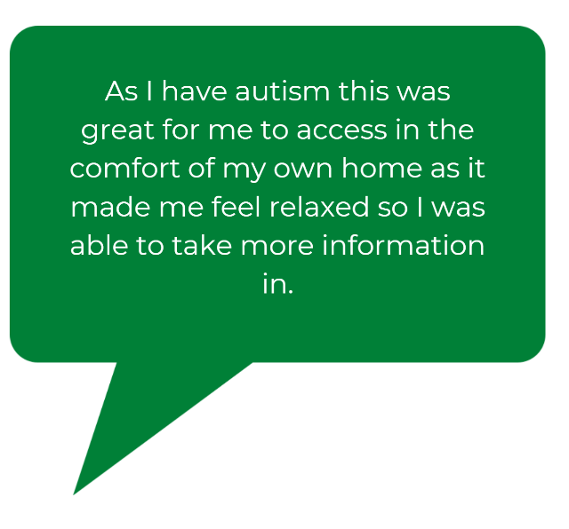
Participants Feedback

Slide 12
COVID-19
In March 2020, due to the Covid-19 pandemic, the Community Connectors suspended all outreach activities.
The Connectors made ‘Welfare Calls’ to discuss wellbeing and helped to ease concerns around benefits, home schooling and Covid-19 restrictions.
The Community Connectors supported women with money advice, assisting with food banks and applications to Universal Credit to ensure those that needed it got the financial assistance they were entitled to.

Slide 13
Working with Partners
A’aina Women’s Hub: supporting the female BAME community, promoting ESOL and wellbeing.
Walsall Black Sisters Collective: deliver our Empowering Women's Workshops with the Aaina Hub, also offer counselling and support with volunteering.
Steps to Work delivered Motivate your Mind
Women's Refuge, Probation Services, Black Country NHS Trust, Faith and Belief Forum, Walsall College, Walsall College, Walsall Works, Black Country Impact, YMCA, My Time Active, Smart Works, Rycroft Community Hub (Gio’s Italian Restaurant).

Slide 14
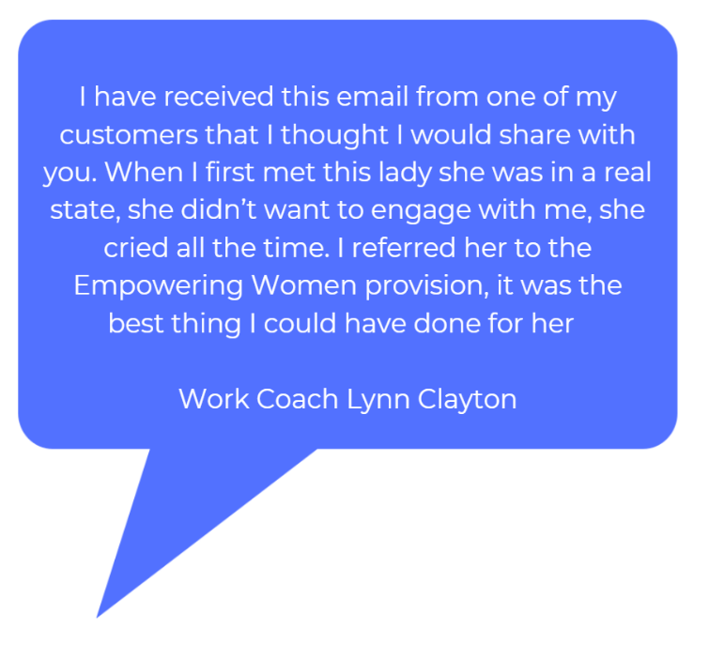
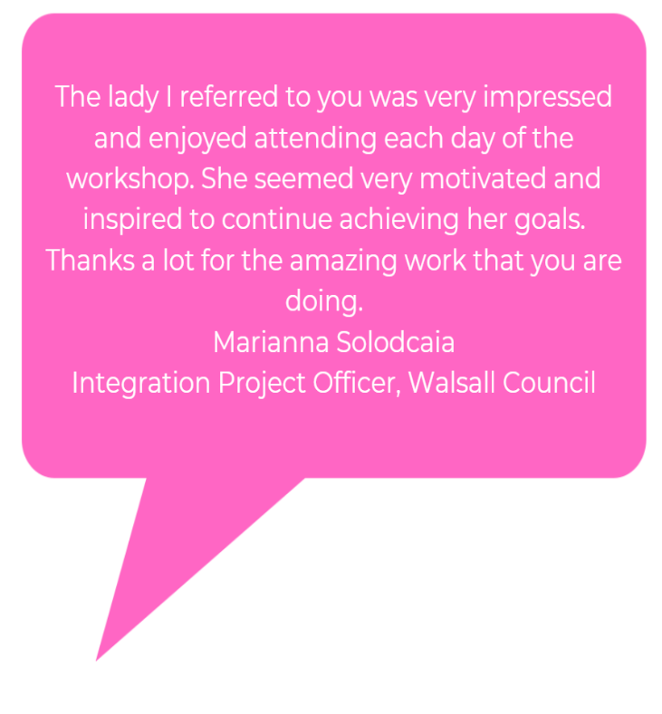
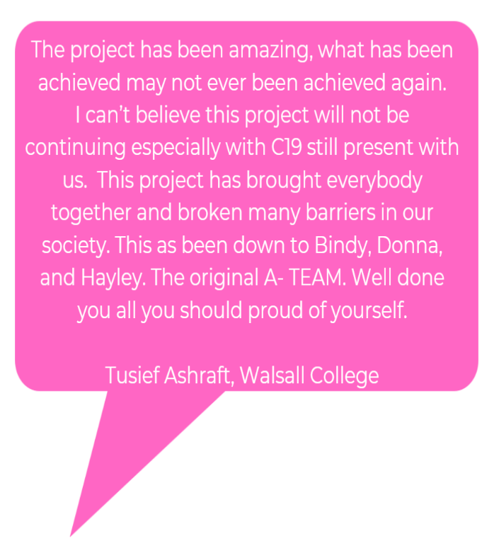
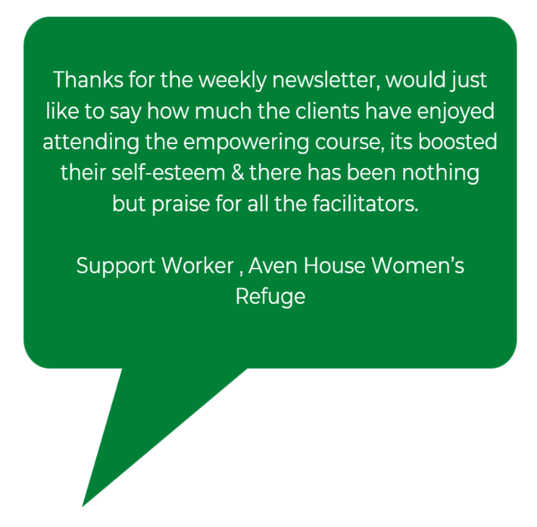
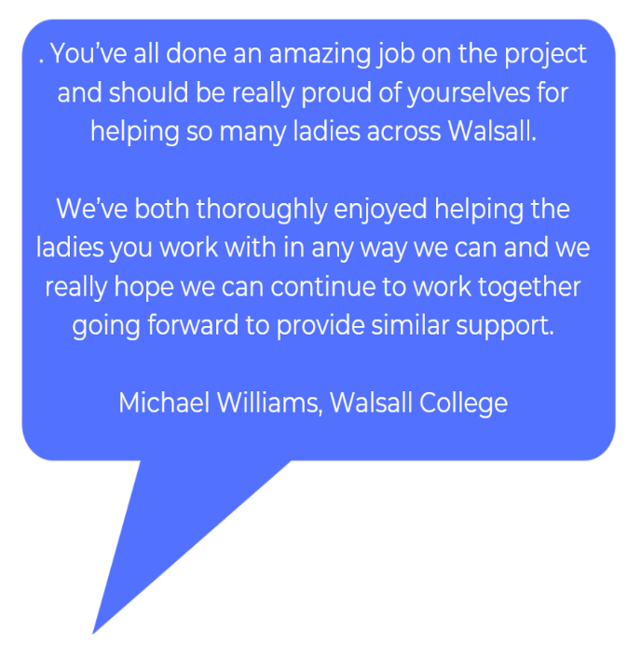
Partner Feedback

Slide 15
Case Study
The Community Connector had two customers referred to her by two Work Coaches at a local Jobcentre. The customers were sisters and from the Traveller Community. They were unable to read and write and their parents were reluctant to allow them to engage in any learning where there may be a large male presence. Both customers were interested in courses in beauty. The Community Connector researched courses at a local Community Centre (a smaller venue as oppose to a College) where they already used facilities to deliver Coffee Mornings. They offered a range of different courses in the Hair and Beauty industry. On 11.10.19 the Community Connector arranged a meeting with the 2 ladies and arranged to meet a Black Country Impact Employment Adviser to register with Black Country Impact, in order to fund the courses in Hair and Beauty at the Community Centre.
The Community Connector continued to liaise with the Training Provider, to enable the 2 ladies to start a Level 3 Nail Art Course. The Training Provider was able to offer a scribe to support with any reading and writing required. The Community Connector and one of the Work Coach’s met with the tutor after they had completed the course to discuss options to move forward and enable to offer options to the ladies to continue their learning in this industry. The tutor commented how one of the ladies has a flair for art and her drawing skills are amazing. So they felt the best way forward was to continue to complete courses in Hair and Beauty and try to look at the courses which may include a bit of creativity so both ladies were interested (their parents were keen for the ladies to attend the Community Centre together and as their Mother had visited the Centre was happy for the ladies to continue to attend.)
Please do not share this externally, as permission has not been given to do so.

