Slide 1
Walsall Public Health – Mental Wellbeing and Suicide Prevention
2nd March 2023
Nazmin Khanom - Public Health Officer
Notes:
Encourage attendees to use wellbeing plans with the public
Encourage colleagues to access mental wellbeing and SP training
Promote grant opportunities
Request for partners to support young people enterprise programme

Slide 2
Agenda
Walsall Data around Mental Wellbeing and reason why we need to focus on mental wellbeing
Key Mental wellbeing projects
Wellbeing Grants
Wellbeing Plans
Suicide Prevention and Mental Wellbeing Training

Slide 3
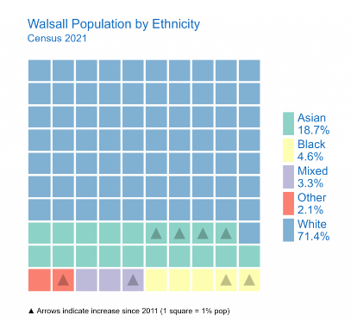
Overview of Walsall Population…

Slide 4
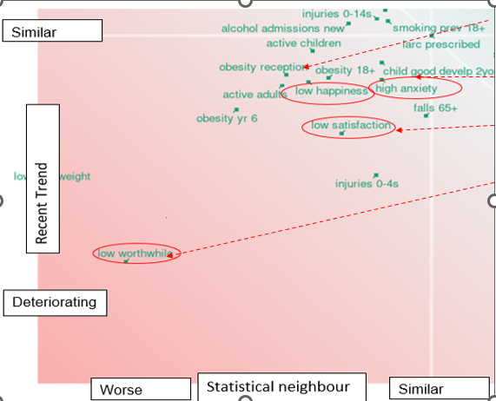
Why Focus on Mental Wellbeing?
Notes:
PH outcome framework data – worse in those circled red than statistical neighbours
MWB strategy

Slide 5
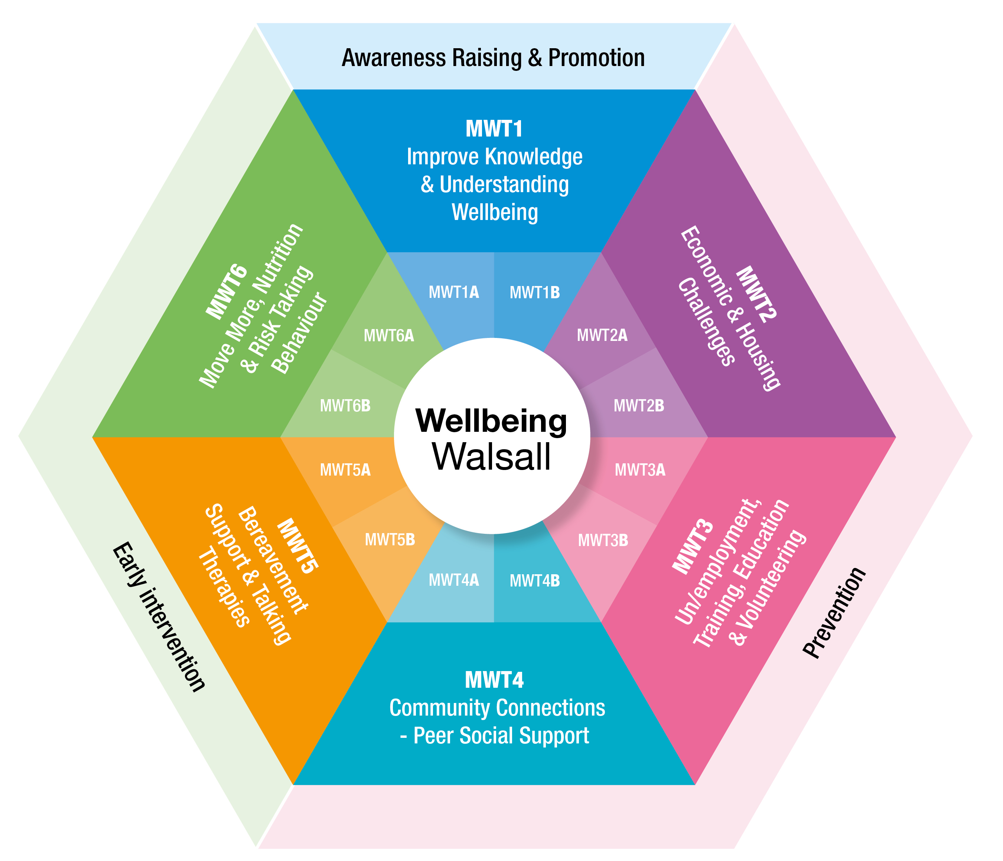
Mental Wellbeing Walsall Grant Funding
General Grants
Grants for Neurodiverse
Grants for Men
Grants for Young People
Notes:
General - Address inequalities and Actively promote elements of good mental health practices in delivery
Neurodiverse – isolation, loneliness, suicide – increased risk. Providing people with a learning disability and autistic people of all ages experience high-quality, timely support that respects individual needs and wishes, and upholds human rights
Men – Higher risk of suicide and lack of receiving support, barrier at crisis point. Stigma remains a huge barrier, both for the public at large and for those dealing with mental health conditions and symptoms.
Research suggests men require help that meets their preferences, is meaningful to them, is accessible and is engaging. For example, Men’s Sheds provide community spaces where men can connect and chat, over practical activities
YP - Walsall fares particularly badly in terms of income (16th), education, skills & training deprivation(11th) and employment (38th) and many of the issues that challenge the borough match the geography of deprivation.
Offering funding opportunities to young people, age of 16-30 year olds in the form of grants to those living in areas of deprivation and socioeconomic disadvantage who are young carers, not in education, employment or training (NEET).

Slide 6
Why Neurodiversity?
People who have a neurodiversity (i.e. Autism, ADHD, Dyslexia etc.) are at an increase risk of:
Experiencing long term unemployment, poor quality employment, and limited opportunities
Social isolation
Social economic deprivation
Poor mental health and suicide
Aim is to:
Encourage higher level of aspiration
Enable participants to learn from hands on practical learning in real life context, raise aspirations and develop career intentions.
Support volunteering opportunities to build portfolio for future opportunities
Work with organisations to ensure delivery is in place to accommodate to those who come under neurodiversity
Notes:
align with the mental wellbeing 23/33 strategy and align with the thematic wheel
Neurodiversity
This grant is broad providing organisations to be innovative with their delivery with improving mental wellbeing in their delivery.
Objectives:
Deliver mental welling elements this could entail of the components in the 8 steps to mental wellbeing plan / Increase the number of organisations signing up to the No Wrong Door System and delivering wellbeing plans with service users.
Address inequalities
Actively promote elements of good mental health practices in delivery
Increase the number of organisations signing up to the Mental Wellbeing Prevention Concordat. The Mental Wellbeing Prevention Concordat is an agreed set of actions owned by local organisations to improve population mental wellbeing.

Slide 7
Why Men?
Men:
Are less likely to:
talk about mental health
receive counselling/ therapy
And are more likely to:
struggle to access support
than women to go missing, sleep rough, become dependent on alcohol and use drugs frequently
Require help that:
meets their preferences
is meaningful to them
is accessible and is engaging
Aim is to:
improve the wellbeing of men
provide safe places where men can access support
improve bond between men and encourage participation in group activities
encourage open conversation about mental health with others
reduce the risk of suicide in men
Notes:
align with the mental wellbeing 23/33 strategy and align with the thematic wheel
This programme will contribute to delivery of the priorities within the Walsall Multi-Agency Mental Wellbeing Strategy in line with the Wellbeing Walsall Thematic wheel.
Men
Stigma remains a huge barrier, both for the public at large and for those dealing with mental health conditions and symptoms. It is well recognised that men’s health is a major concern. This programme seeks to explore different approaches to increase acceptability amongst men to talk about mental health distress and need.

Slide 8
Young People
Why young people?
The long-term impact of Covid on young peoples employment is forecasted at £14.4 billion over the next seven years
Young people with poor mental and emotional wellbeing are more likely to be drawn into negative behaviours such as smoking, alcohol and drug misuse
Education, skills and training outcomes are lower in Walsall compared to national average
Young people have a low level of awareness of the opportunities available to them
By prioritising young peoples opportunities we can improve long-term mental wellbeing outcomes
Projects to be delivered by young people for young people are to:
Improve mental wellbeing
Increase opportunities
Increase confidence
Increase aspiration
Increase awareness of local services available
Projects must tackle mental wellbeing inequalities by targeting intervention towards the communities with the greatest need.

Slide 9
Wellbeing Grants – Key Dates 2023
Grant Framework | Men’s Grants | General Grants | Neurodiverse Grants | Young People Grants
Grant publish date | Friday 10 March 2023 | Fri 10 Mar 23 |  | Friday 17 March 2023
Q&A session | Monday 27 March 2023 (PM) | Mon 27 Mar 23 (PM) |  | Monday 3 April 2023 (PM)
Submission times scales | Monday 17 April 2023 noon | Mon 17 Apr 23 noon | Monday 24 April 2023 noon | Mon 24 Apr 23 noon
Please note this is the current proposed plan
Notes:
Dates of YP enterprise to be adjusted

Slide 10
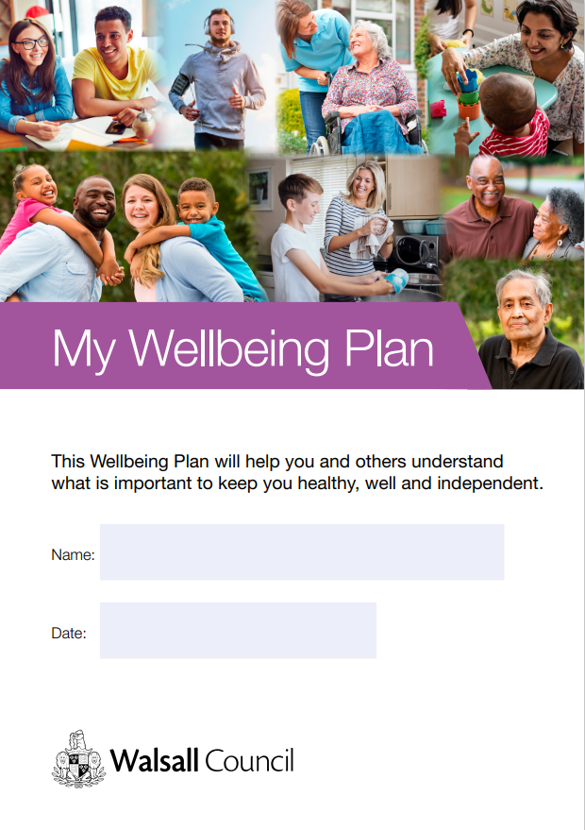
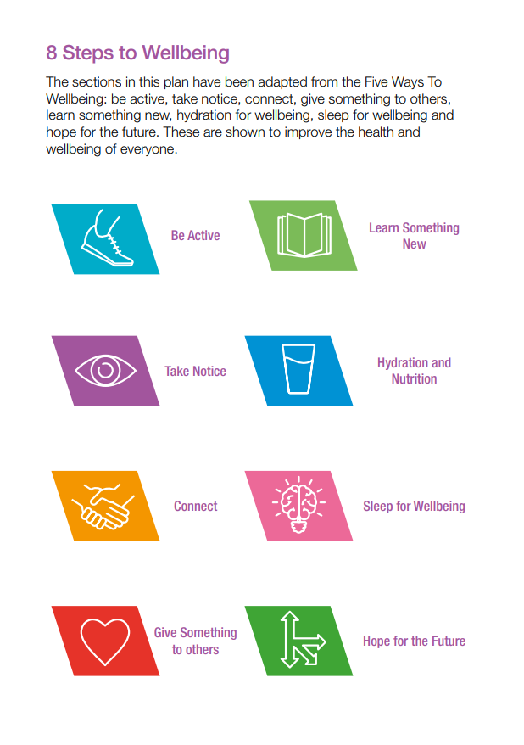
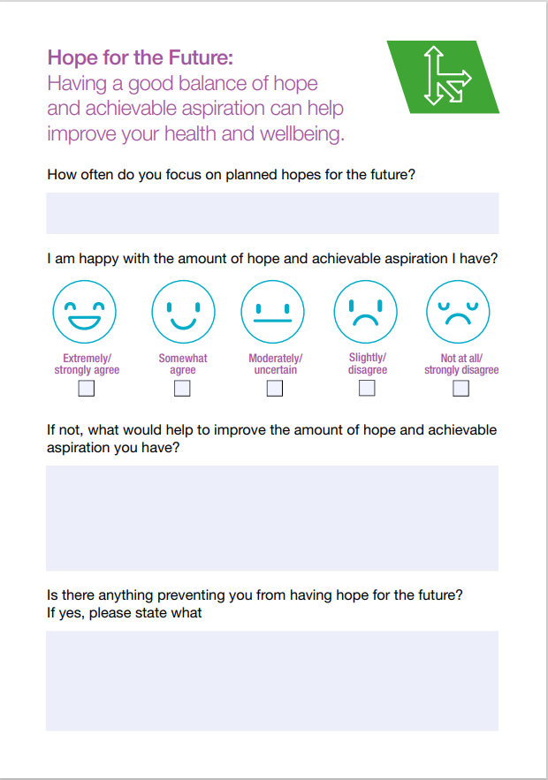
Wellbeing Plan
Notes:
Using wellbeing plan with community members

Slide 11
Mental Wellbeing & Suicide Prevention Training
FREE offer to you:
Mental health, wellbeing and suicide prevention training - 1/2-day session
Train the trainer - 90 minutes
Forward awareness training delivered by the trained trainers – 30 mins
Virtual support group and the provision of on going support to delegates
Notes:
The aim of this training is to
To recognise when people are in need and know how to support them appropriately
Improve confidence in communicating sensitive information, increase early recognition of mental health problems in diverse communities/groups.
Develop the community competence to enable the development of a network of champions/ residents within communities
Enhance the ability to answer questions and support concerns around mental wellbeing including how to tackle stigma and identify early signs.

Slide 12
Thank you!
For more information contact:
Nazmin.khanom@walsall.gov.uk

