Slide 1

Investing in Social Cohesion -
Lessons learnt
Jo Broadwood, CEO, Belong

Slide 2

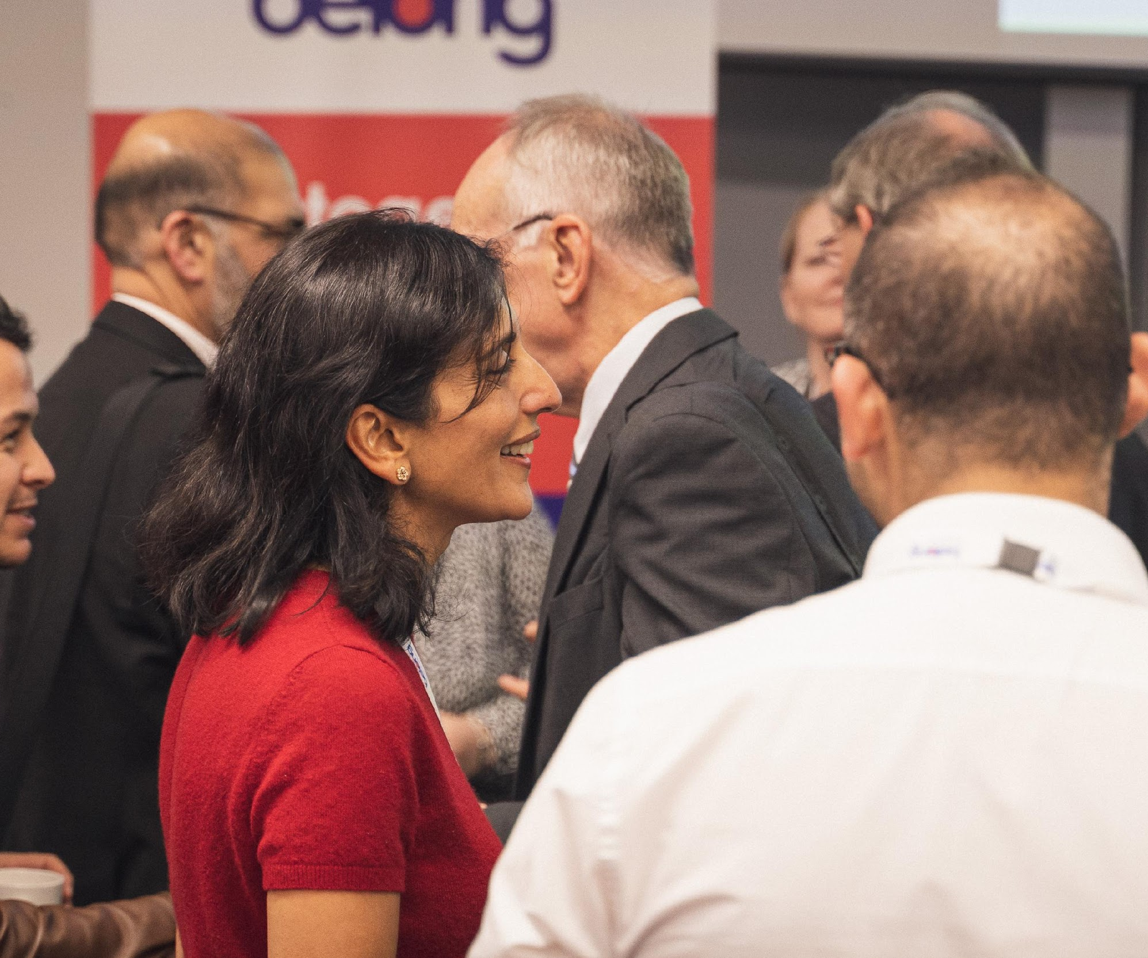
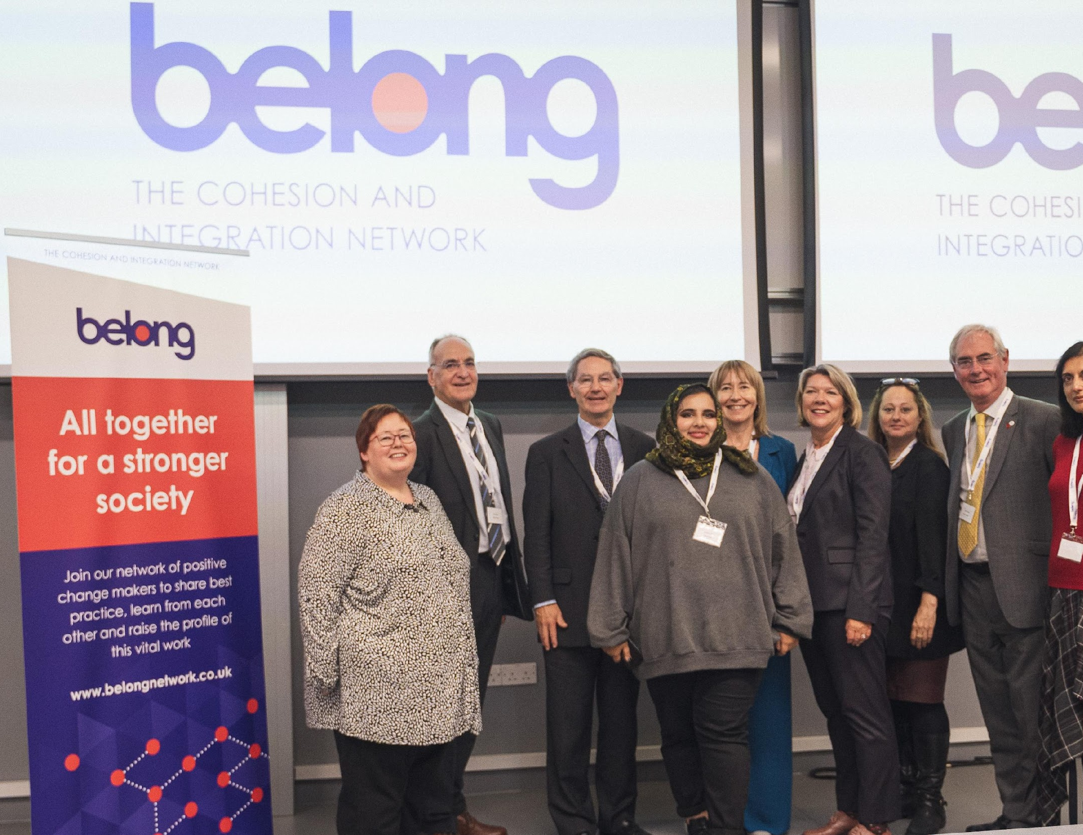
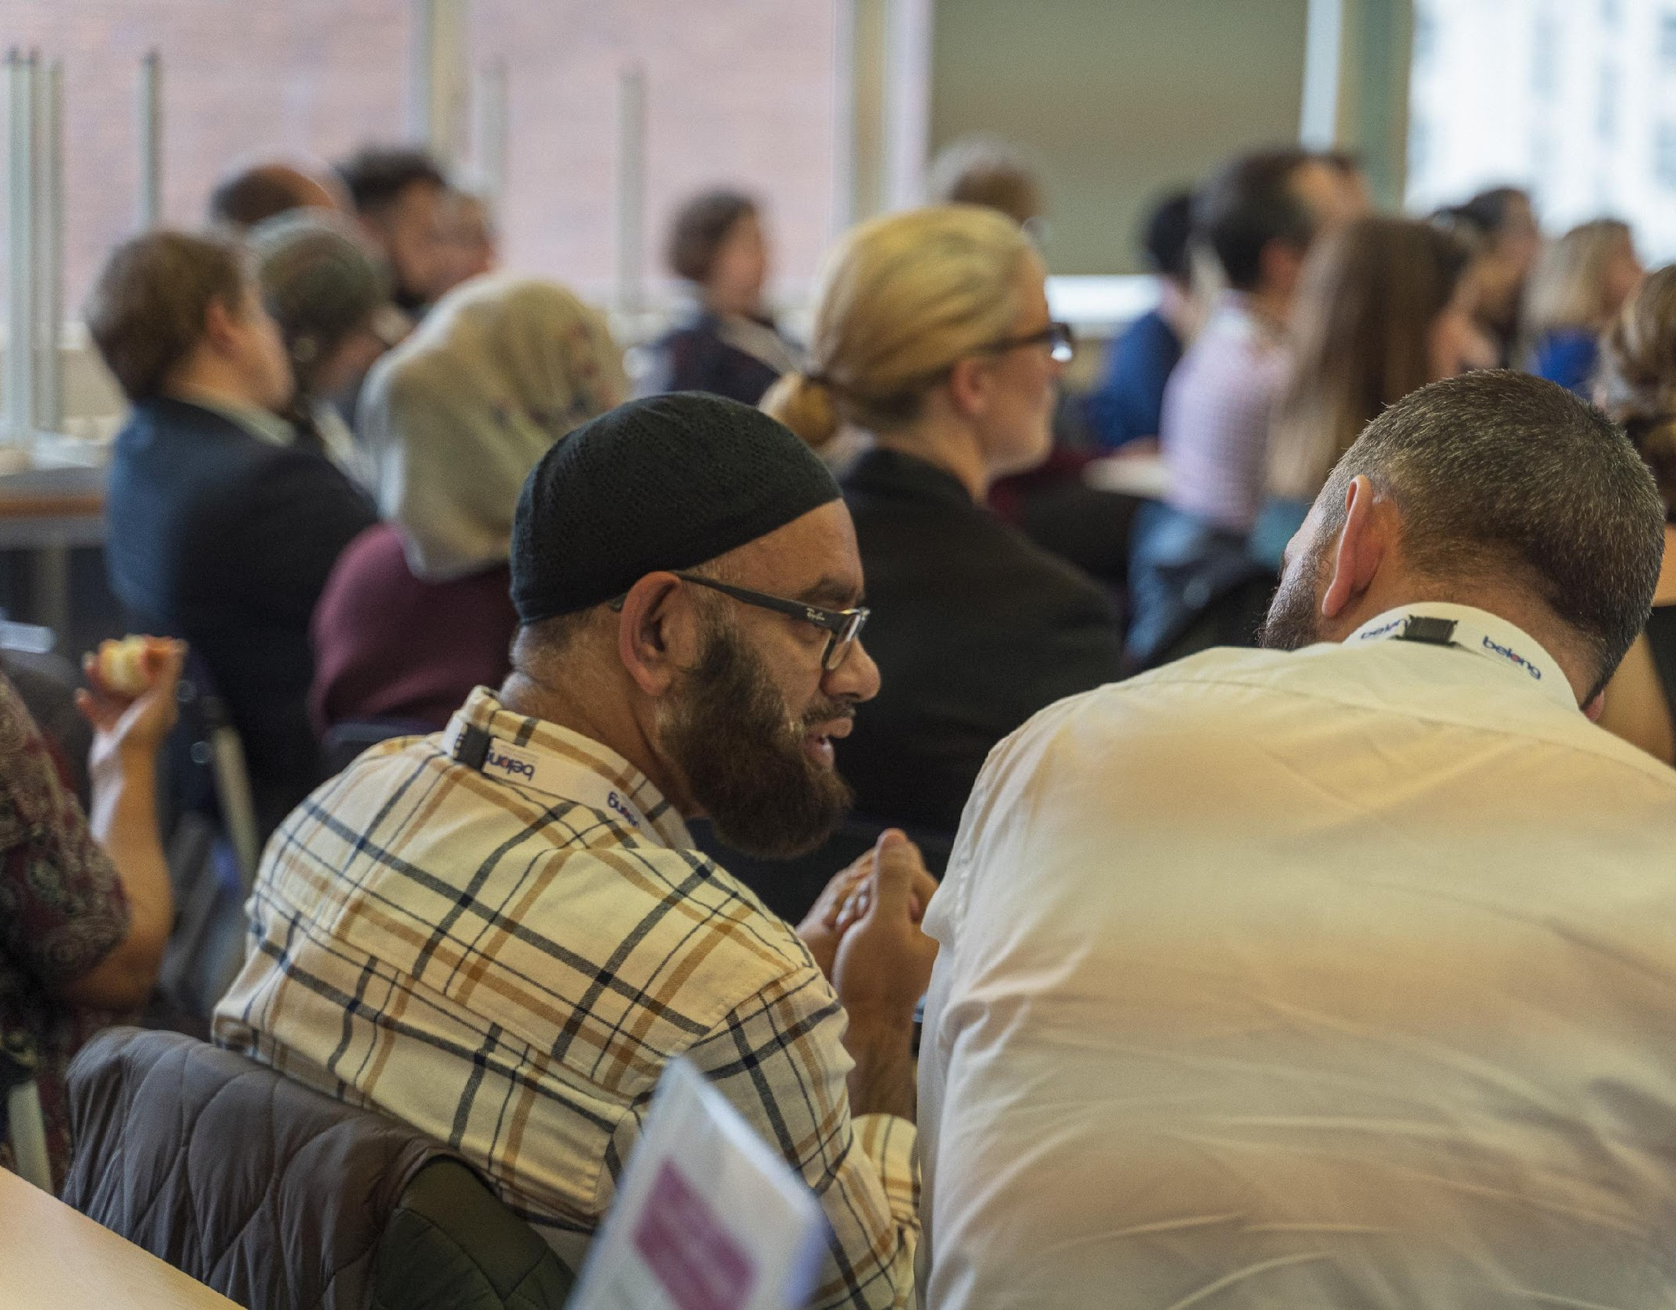
Belong -
The Cohesion and Integration Network
National Charity and membership network
With our home in Manchester
More connected, less divided society
Improving practice and transforming policy
Evidence based and research led
Connecting across sectors and geographies
Providing knowledge, resources and skills

Slide 3
What do we mean by cohesion & integration?
Terms that describes how well people from different backgrounds mix, interact and get along with each other.
Building cohesion and integration is about developing neighbourhoods, workplaces, institutions and social spaces where difference is welcomed and celebrated.
It is about moving beyond narratives of “us” and “them” towards ideas of trust, shared identity and a sense of belonging.
Most importantly it is about Relationships
Notes:
Dom - is this about right in layperson’s language?
Need to t

Slide 4
Why does it matter?
Pre-pandemic – low levels of social mixing
During the pandemic restrictions on movement meant social mixing even less likely and unlikely that we have gone back to levels of social mixing pre-pandemic
Incredible outpouring of community spirit and support in the early months
Understanding Society study suggests cohesion decreased
Increase in hate crime towards some groups
Beyond Us and Them research project saw both unity and division
But some areas were more resilient….

Slide 5



Three types of relationships that are crucial to social cohesion:
Bonding
Bridging
Linking

Slide 6
Understanding place:

Slide 7
Understanding place
Notes:
Dom - is this about right in layperson’s language?
Need to t

Slide 8
Social Cohesion as both a state and a process
Trust in local govt & institutions
Social Mixing
Trust in, & perceptions of, others
Active social engagement
Social connections
#BeyondUsAndThem

Slide 9
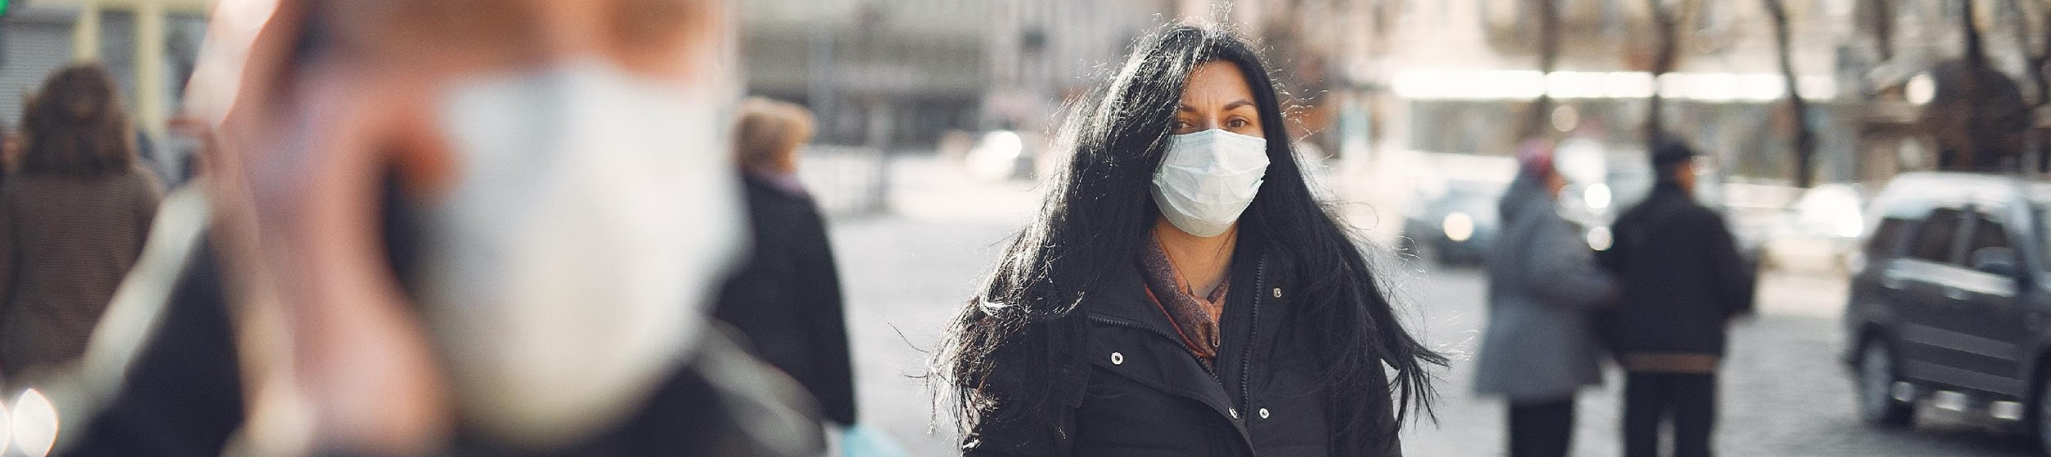


Beyond Us and Them Research Project (May 2020 – March 2022)
How is the COVID-19 pandemic affecting relations between individuals, communities and the state and what can we learn for the future?
Surveys in 13 places, with boosts for Black and Muslim groups
Repeated 3-8 times between May 2020 and July 2021 (39,000 respondents in total)
61 focus groups and 256 one-to-one interviews
Notes:
Introduce the Beyond Us and Them study

Slide 10
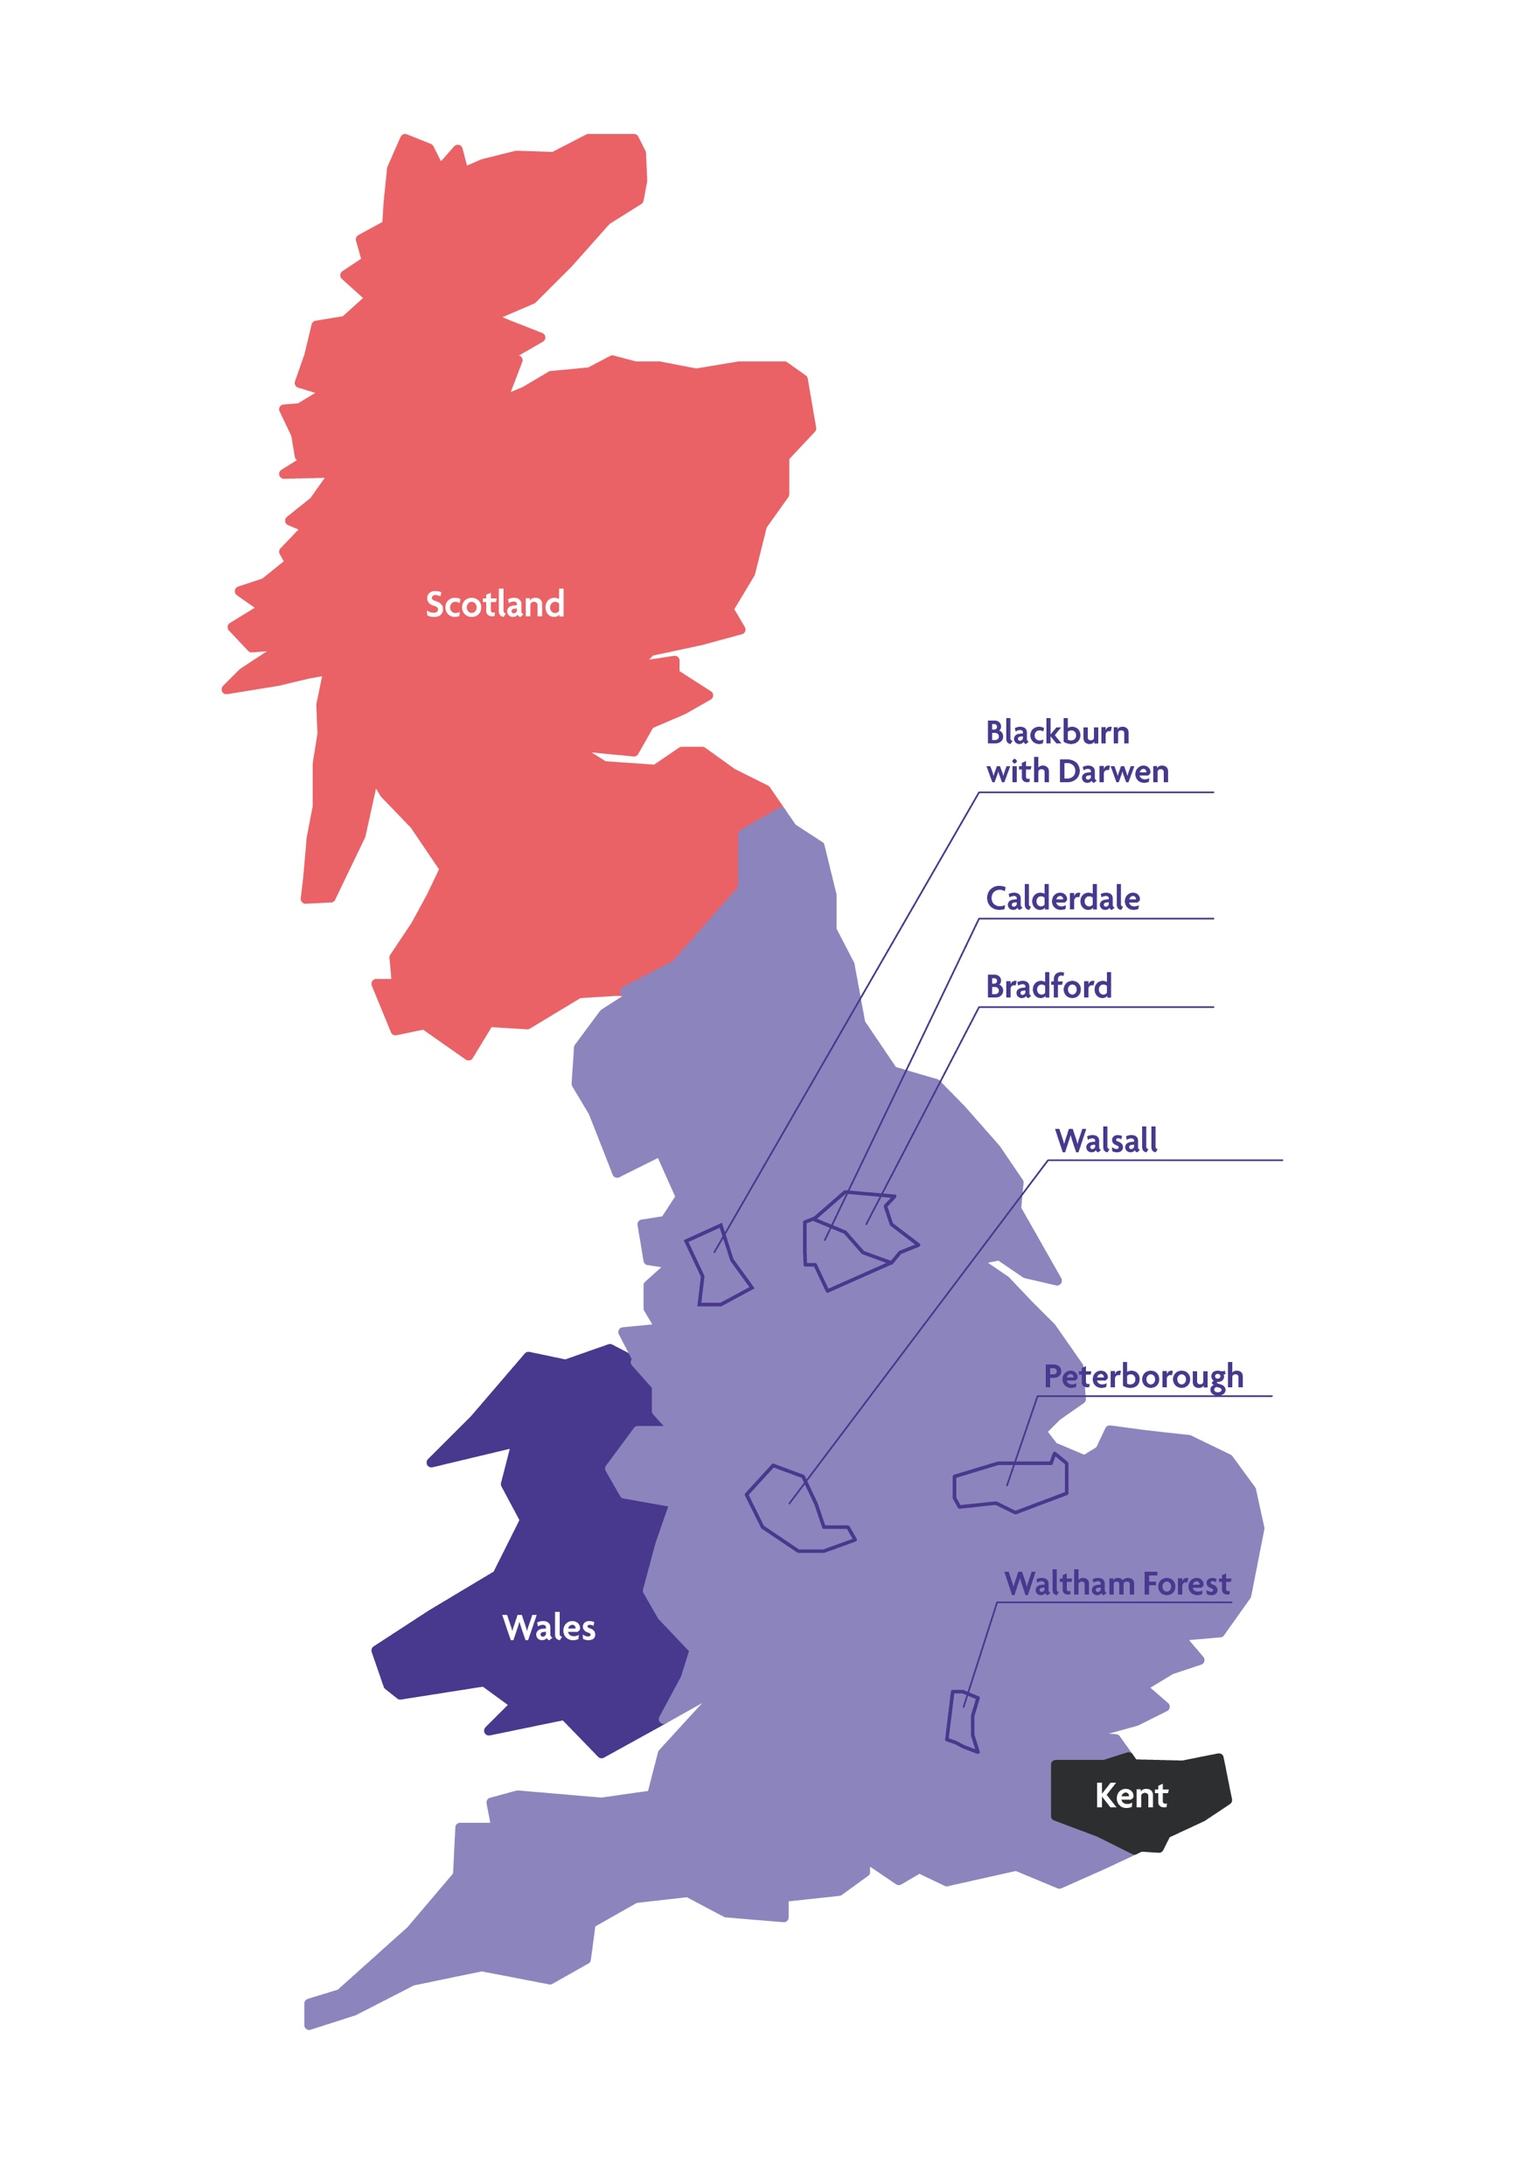
Research focus:
- 3 contrasting national contexts
6 Local Authority ‘social cohesion investment’ areas
4 metropolitan areas (GLA, GMCA, WECA, WMCA)
via our community partners
Minority boosts (Black, Muslim)
Notes:
Dom - is this about right in layperson’s language?
Need to t

Slide 11

Social Cohesion Investment
In June 2021, respondents in the six local authority areas reported:
Higher levels of trust in national gov (+10%)
More positive about local gov’s response (+8%)
Closer relations with family, friends, colleagues and neighbours (+19%)
Stronger sense of neighbourliness (+4%)
Greater active social engagement (+18%)
Higher levels of subjective wellbeing

Slide 12
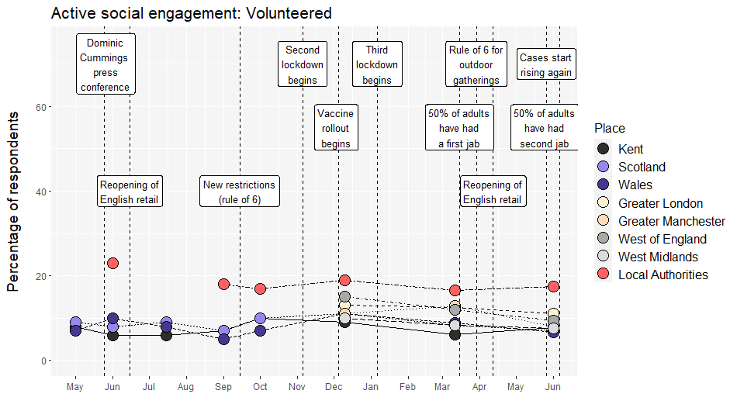
Social engagement – e.g. volunteering
Percentage of respondents who reported volunteering during the past month May 2020 – June 2021

Slide 13
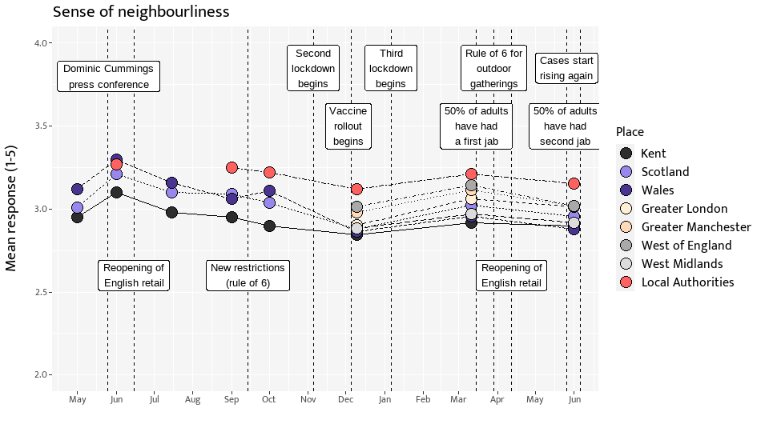

Slide 14
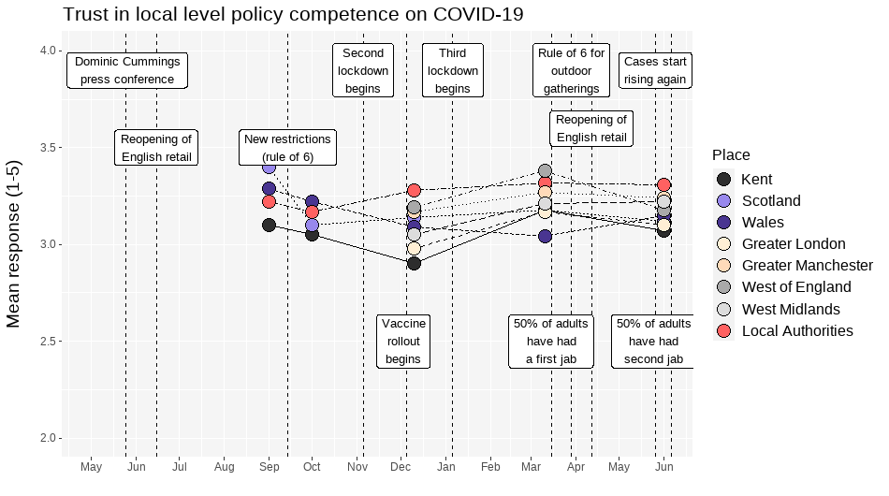
Trust – Local Competence

Slide 15

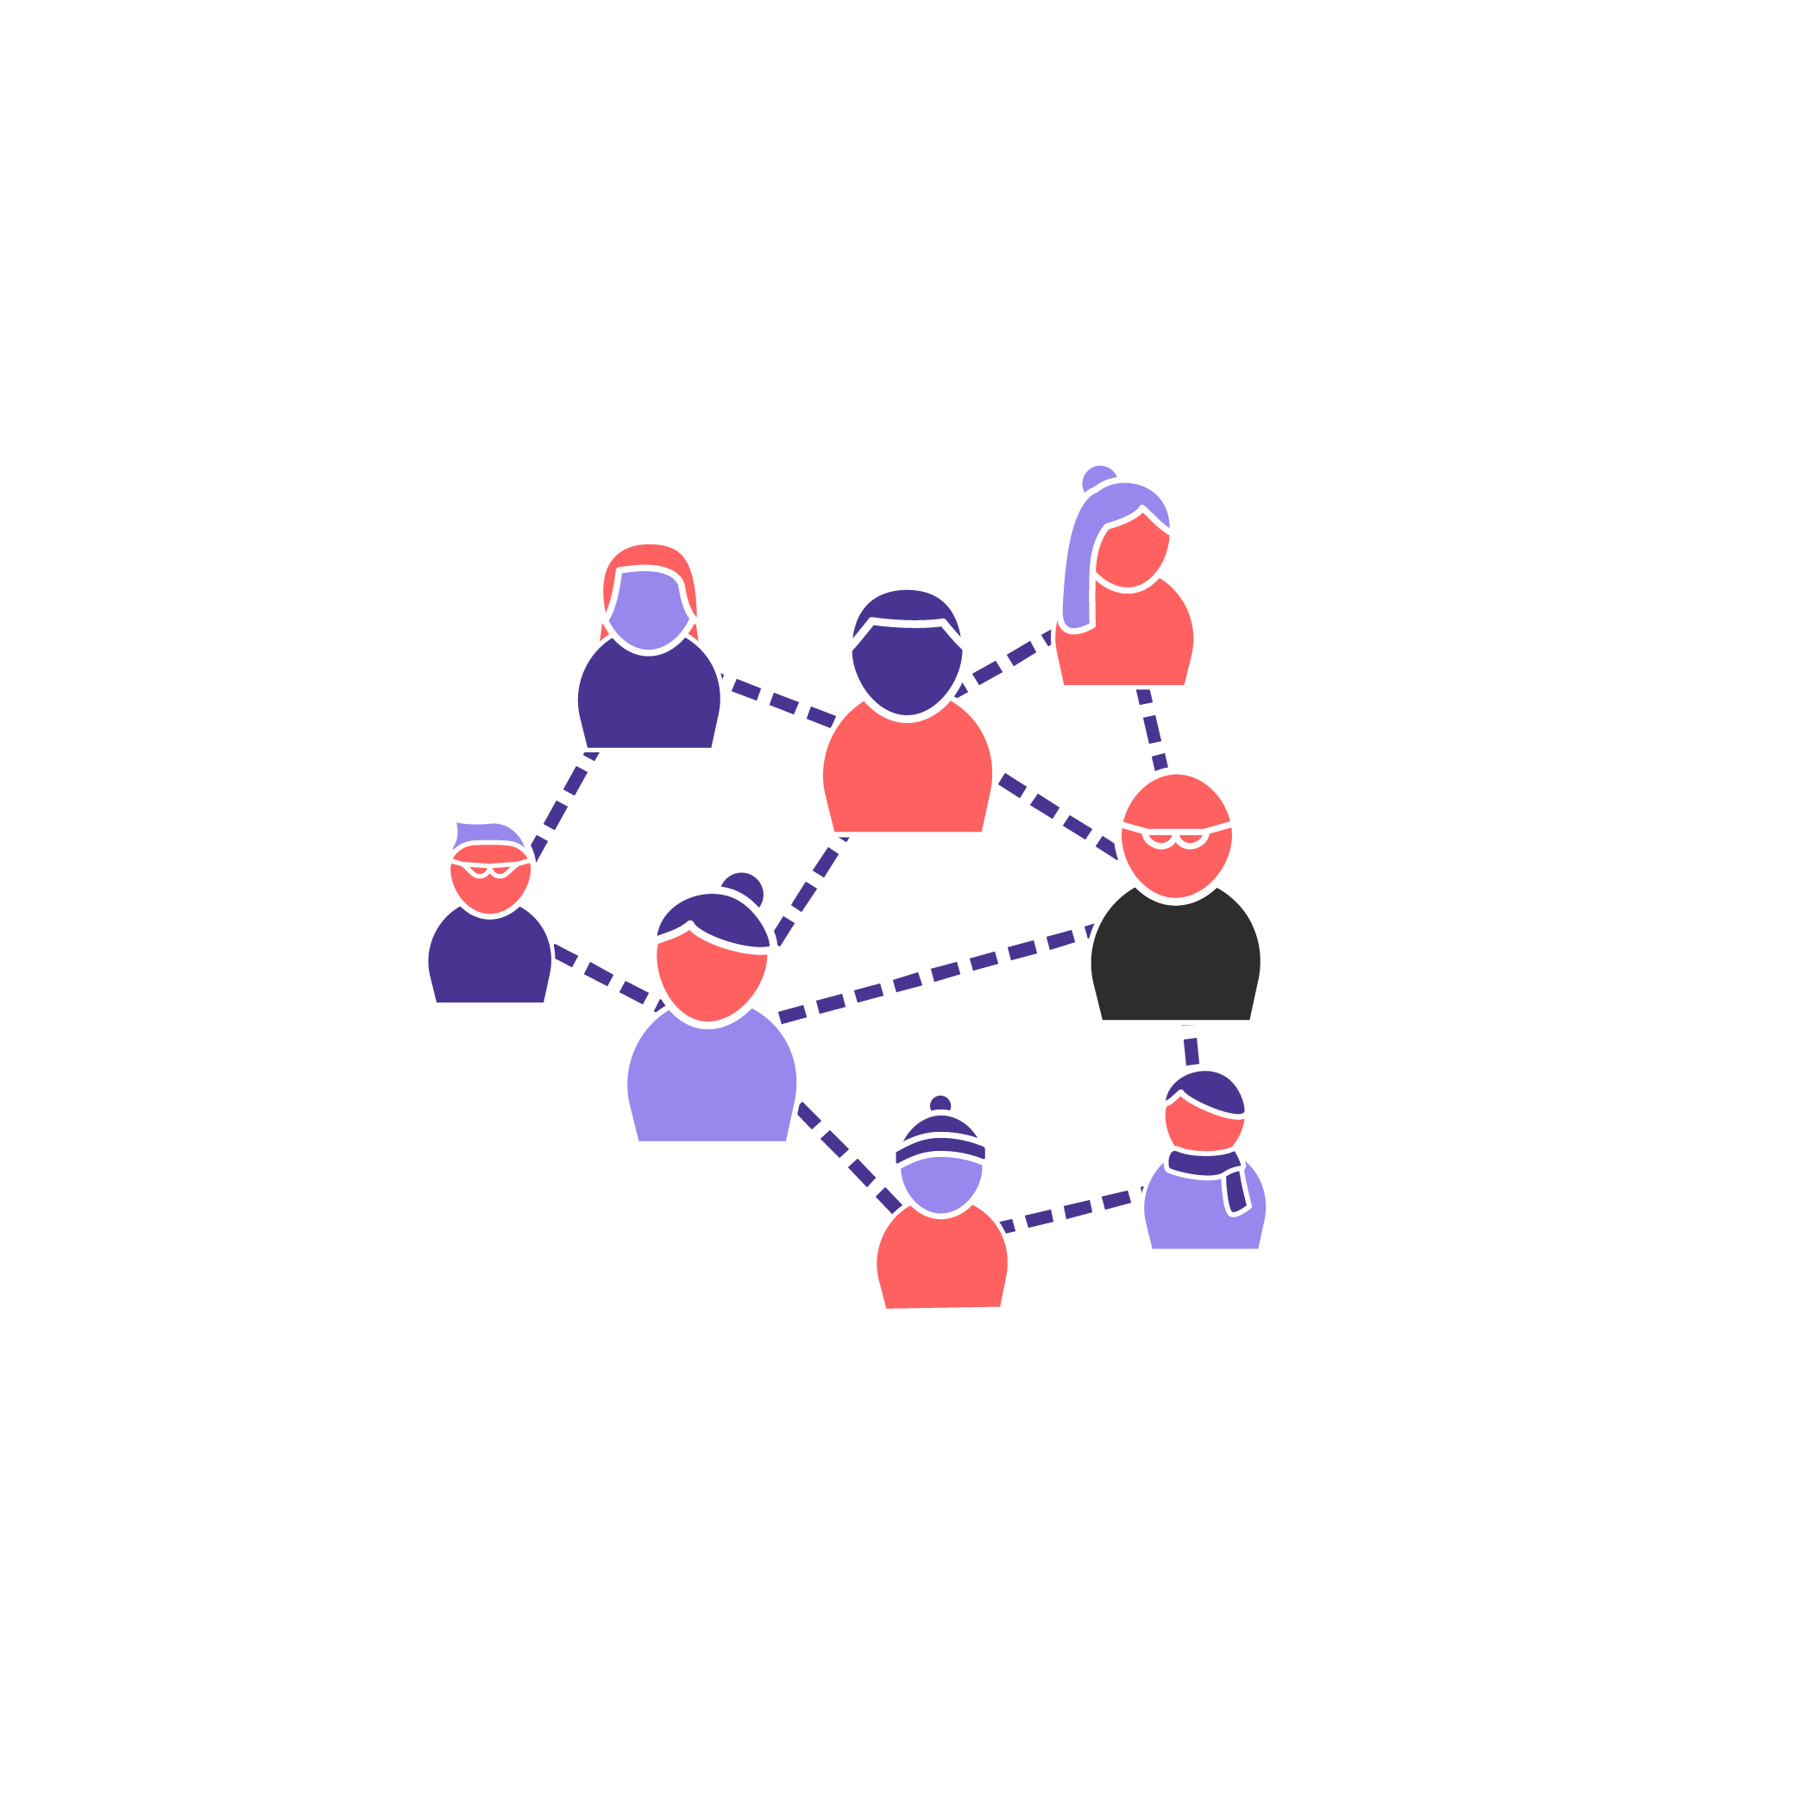
The Four Pillars of the social cohesion programmes:
Place
People
Knowledge
Systemic barriers
(Power, Agency, Voice)
Notes:
Dom - is this about right in layperson’s language?
Need to t

Slide 16
Place
The role of local gov reimagined as a co-producer, convener and enabler
A strong, connected and diverse local voluntary and community sector
Cross-sector partnership bringing together private, public and civil society actors to marshal their resources towards the shared vision and plan
Common places, and places in common
Arts, sports and cultural activities and events which put communities in charge
#BeyondUsAndThem

Slide 17
People
Promote leadership that is inclusive, representative, welcoming and actively promotes social cohesion in accessible language
Tackle barriers to inclusion of minority communities and under-represented groups
Encourage active social engagement and promote and celebrate volunteering
Bring people together - support social mixing of people from different backgrounds
#BeyondUsAndThem

Slide 18
Knowledge
Shared framework of local social cohesion measures
A focus on learning and building on what works and evaluation
Build competence, capacity, skills and knowledge on social cohesion across all sectors
Bring in specialist knowledge and skills from outside area
#BeyondUsAndThem

Slide 19
Systemic Barriers
Understand inequalities and how they impact different communities and groups differently.
Tailoring programmes to meet those different needs
Understand factors which help / hinder integration
Address structural segregation and barriers to social mixing.
#BeyondUsAndThem

Slide 20
QUESTIONS?

